Slide 1
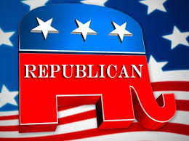
Birth of the Republican Party
Ripon, Wisconsin

Slide 2
Remember there were other political parties already around…for example the…

Slide 3
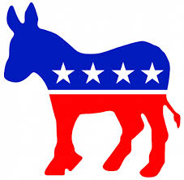
Democratic Party
The modern Democratic Party was founded around 1828 with roots in the Democratic-Republican Party
The first Democratic president was Andrew Jackson.
Supported:
- states’ rights
- An agrarian economy
strongest support in the south
Opposed
- government limitation on
personal liberty

Slide 4
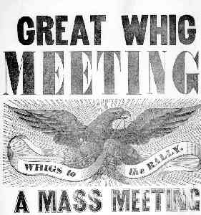
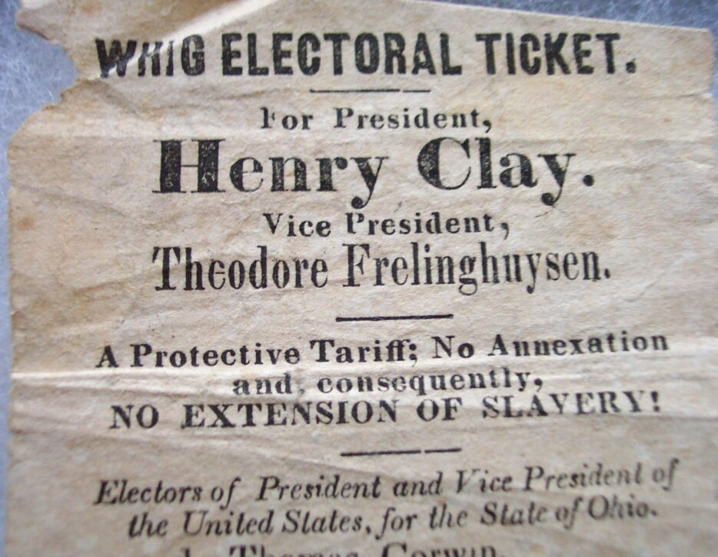
Whigs
Founded in 1834 to oppose Andrew Jackson
Win Presidential Elections of 1840 (Tyler) and 1848 (Taylor)
Fall apart in 1852

Slide 5
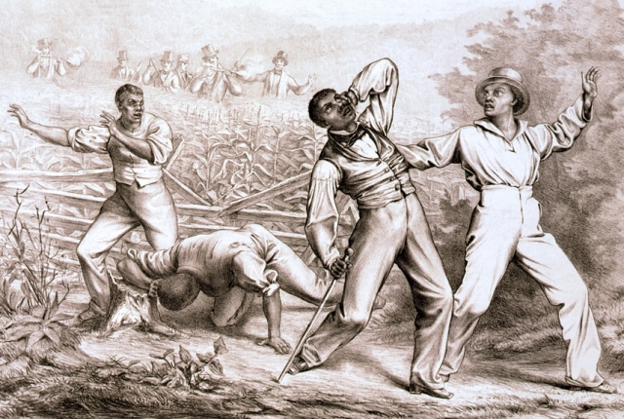
Based on the information below…Why did the Whig party fall apart?
Northern (Conscience) Southern (Cotton)
* opposed Fugitive Slave Act * supported Fugitive Slave Act
* opposed Compromise of 1850 * supported Compromise of 1850

Slide 6
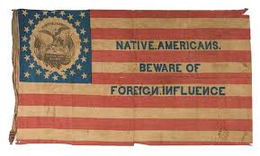
Know Nothings
Formed around 1849-50
Really called the American Party but because they used a secret handshake and said “I know nothing” when asked about their activities they soon were called the Know-Nothings
Supported:
Longer naturalization period
Opposed:
Immigrants
Catholics (pope threatened democracy)

Slide 7
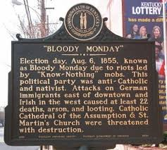
August 6, 1855, an election day, when Protestant mobs attacked German and Irish Catholic neighborhoods.
These riots grew out of the rivalry between the Democrats and the nativist Know-Nothing Party.
Multiple street fights raged, leaving twenty-two people dead, scores were injured, and much property was destroyed by fire. Five people were later indicted, but none were convicted, and the victims were not compensated.
Bloody Monday was sparked by the
Know Nothing political party (officially known as the American Party), an offshoot of the shattered Whig Party, fed in large part by the radical, inflammatory anti-immigrant writings.
Happened in Louisville, Kentucky

Slide 8
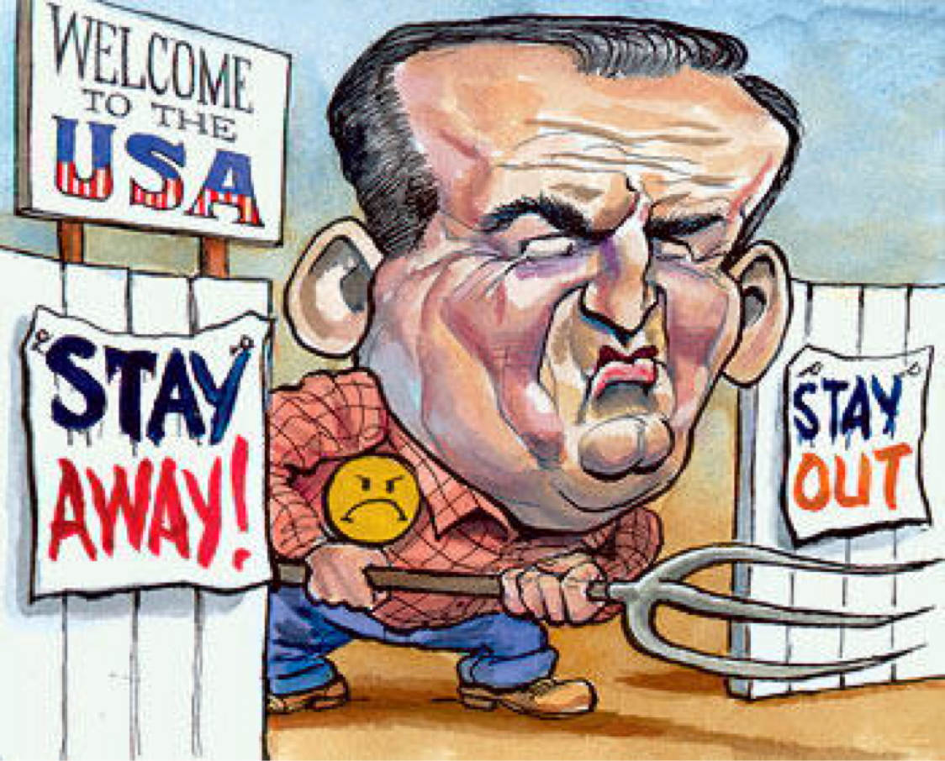
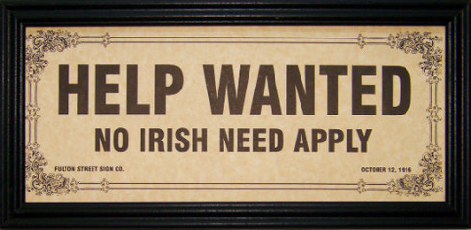
Know Nothings
1854 the party splits over slavery in the territories.

Slide 9
Anti-Slavery Parties
Liberty Party - 1844
- wanted to achieve abolition by passing new laws
Free Soil Party – 1848
Opposed expanding slavery into the new territories
believed slavery should be contained, and that if contained it would ultimately disappear

Slide 10
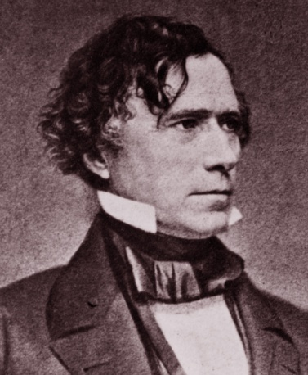
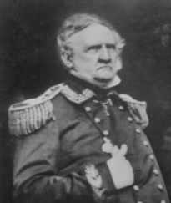
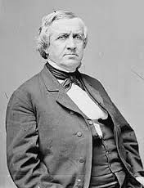
The Election of 1852
Franklin Pierce (Democrat) won
Defeated Gen. Winfield Scott (Virginia Whig) – Lost Whig vote in the South
50.8% - 43.9% in popular vote
254-42 in electoral vote
John Hale (Free Soil candidate) polled 4.9%
Franklin Pierce
Winfield Scott
John Hale

Slide 11
Out of this unsettled political atmosphere came the…

Slide 12
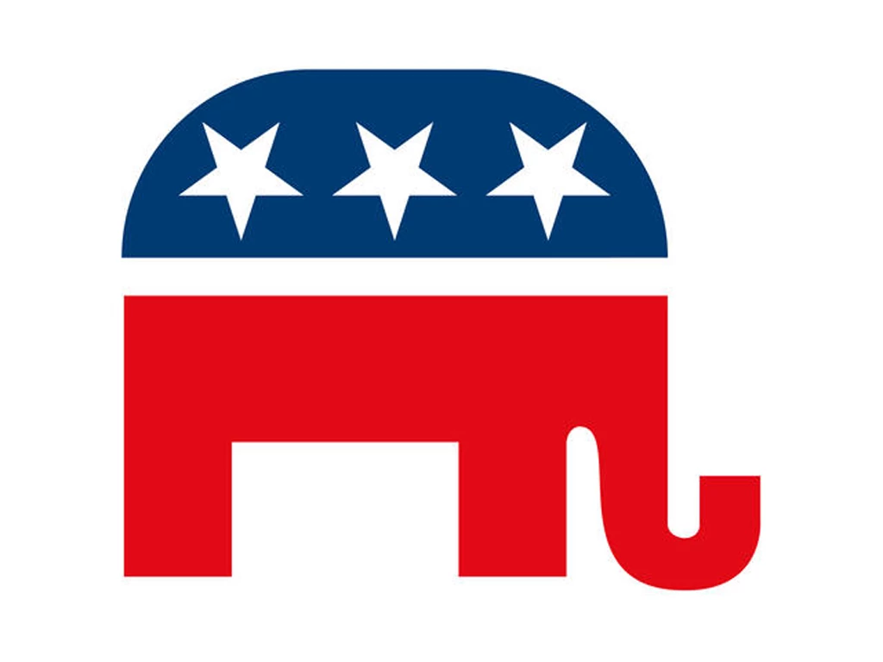
Republican Party
Formed in 1854
Opposed:
Kansas-Nebraska Act
Spread of slavery into the territories

Slide 13
Republican Party
Supporters:
Free - Soilers – people who wanted new territory to be free of slavery
Northern “conscience” Whigs
Anti-slavery Democrats
Temperance supporters
Small farmers who wanted western land
Large farmers who wanted better infrastructure

Slide 14
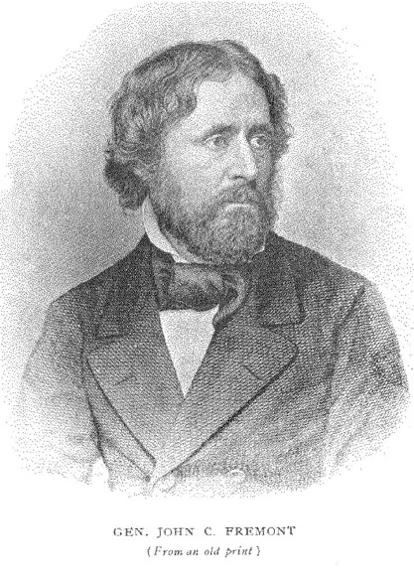
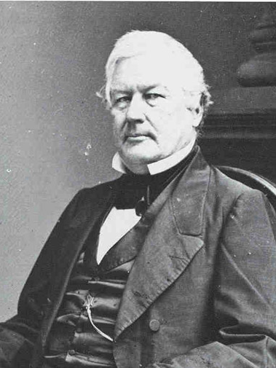
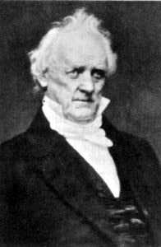
Election of 1856
Candidate | Party | Supported By
John Fremont | Republican | Northern Know-Nothings
James Buchanan | Democrat from Pennsylvania | His Southern friends Northerners | Out of country during incidents in Kansas – “Kansas-less”
Millard Fillmore | Whig | Southern Know-Nothings
James Buchanan
John Fremont
Millard Fillmore

Slide 15
1856 Election Results
What do they mean?
- Buchanan wins
Shows that the Democrats can win with a National Candidate (supported by both the north and south)
Know-Nothings are in decline – basically dead as a party
- Republicans are strong in the North – because Fremont won 11 of 16 free states

Slide 16
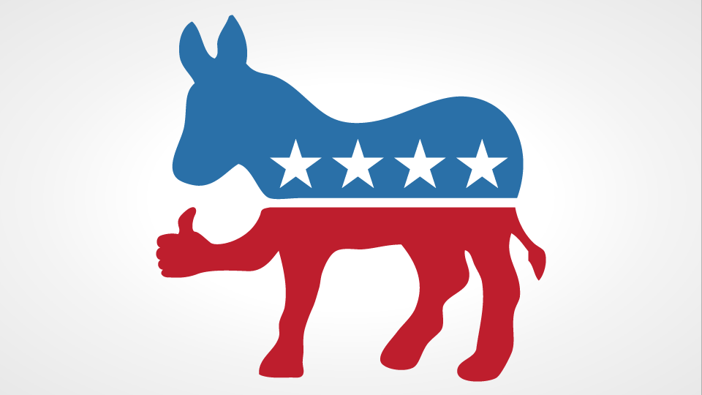
What two parties fell apart in the 1850’s?
Whigs & Know Nothings
The issue of slavery divided both parties and weakened their national power.
What two parties were left?
Democrats and Republicans

