Slide 1
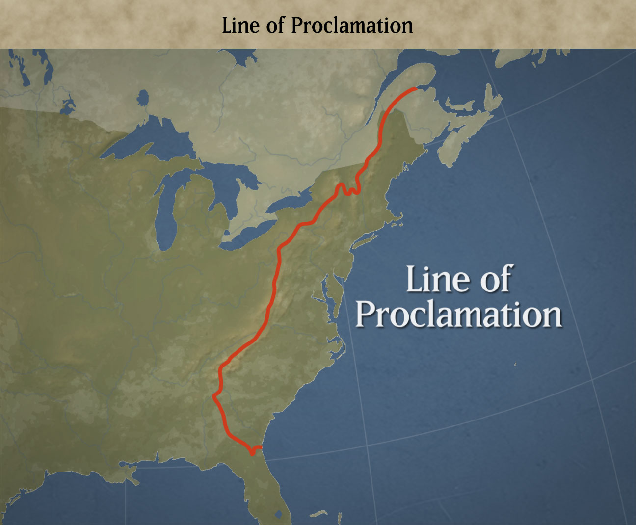
Proclamation of 1763
What?
An order NOT to settle past the
Appalachian Mountains
Why? (purpose)
To avoid further conflict with
Native Americans and because
the British cannot protect colonists in
such a large area

Slide 2
What do you think was the response of the colonists?
Which colonists?

Slide 3
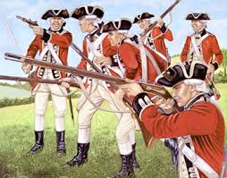
10,000 British Troops left in North America
What
After the French and Indian War the British
left 10,000 British Soldiers in America
Why? (purpose)
To protect the colonists from Native Americans
and French people still in territory that is now British

Slide 4
What do you think was the response of the colonists?
Which colonists?

Slide 5
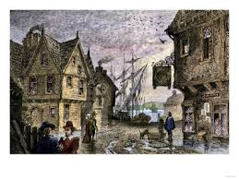
Writs of Assistance
What?
An order allowing British officials to search colonial businesses to look for smuggled goods
Why? (purpose)
To crack down on smuggling
in New England

Slide 6
What do you think was the response of the colonists?
Which colonists?

